Slide 1
Network Topology
GOWTHAM M
23ITR049

Slide 2
Problem Description
• Office network structure unknown
• Adjacency matrix provided
• Goal: Identify topology & suggest improvements
• Identify the type of network topology (e.g., star, mesh, ring).
• Give suggestions to improve the current network setup.

Slide 3
Algorithm Used
• Brute Force method
- It checks all connections one by one.
- It is a simple and direct method.
• Simple & direct comparison
• Fits small/medium networks

Slide 4
Data Structure
• 2D Array (a table format)(Adjacency Matrix)
• Good for dense (many links) networks.
• Easy to understand and visualize.
Recurrence Relation - T(n)=T(n−1)+n

Slide 5
Input Size
• Based on node count (n)
• Matrix size: n x n

Slide 6
Efficiency
• Time Complexity: O(n²)
- each node is compared with every other node.
• Good for small 'n'(Not suitable for very large networks.)

Slide 7
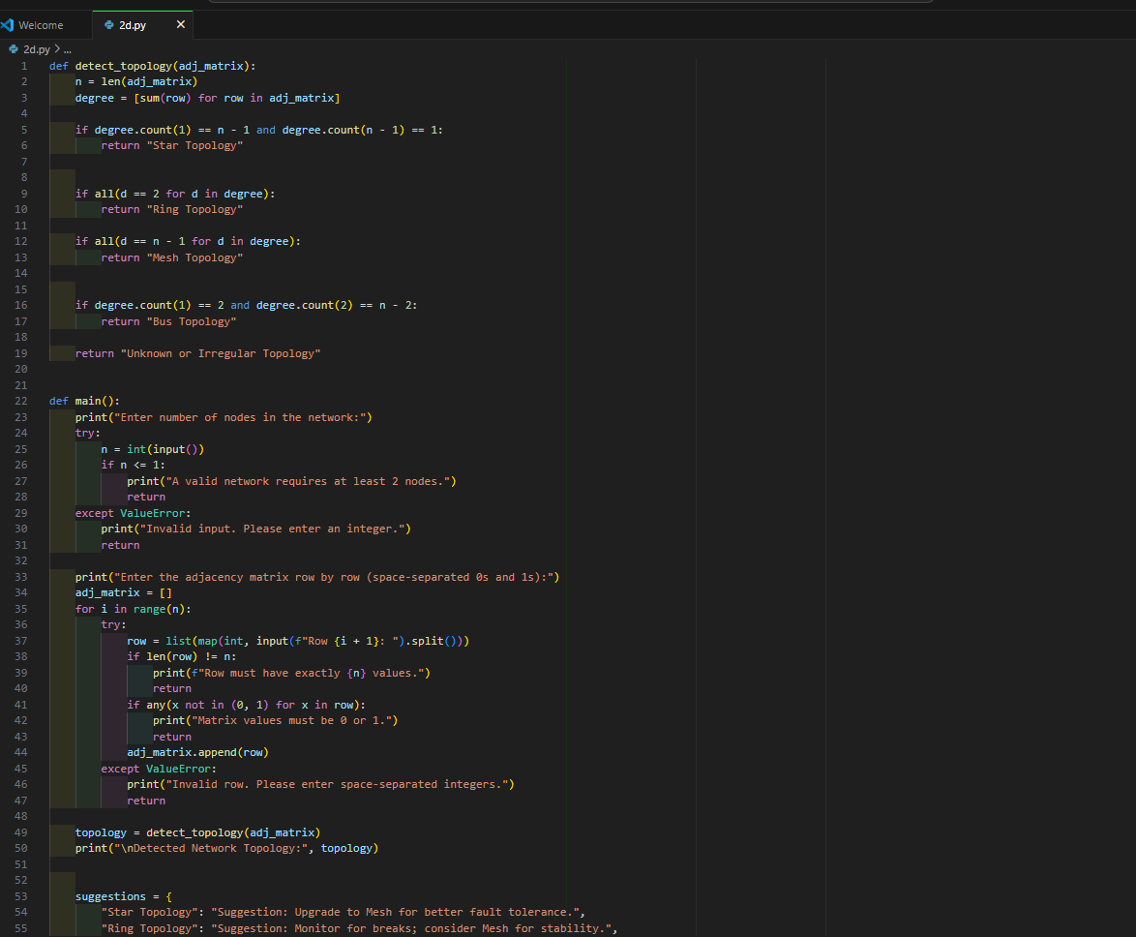
Code:

Slide 8
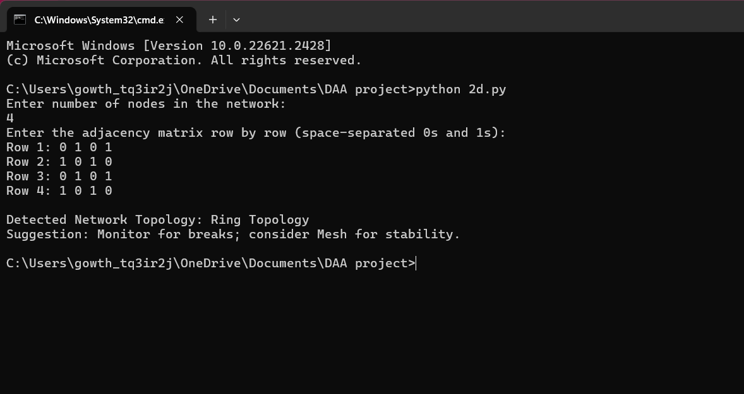
Sample Input / Output

Slide 9
Conclusion
• Brute force detecting the topology from the matrix
• Improves network planning
• Useful for network upgrades
Very useful in small or medium office networks.

